Slide 1
Ordinary Least Squares (OLS) Regression model for HTC

Slide 2
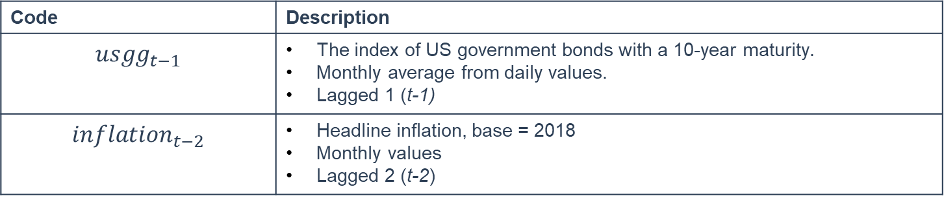
Model (1)
$$BVAL 7Y_{t}=2.52+0.74 usgg_{t−1}+0.24 inflation_{t−2}$$
Code | Description
$$usgg_{t−1}$$ | The index of US government bonds with a 10-year maturity. Monthly average from daily values. Lagged 1 (t-1)
$$inflation_{t−2}$$ | Headline inflation, base = 2018 Monthly values Lagged 2 (t-2)
Note: All the variables are multiplied by 100, e.g., 4% = 4
Model passed linear regression assumptions (see Annex for detailed values)
Cochrane-Orcutt procedure was implemented (see Annex for detailed values)

Slide 3
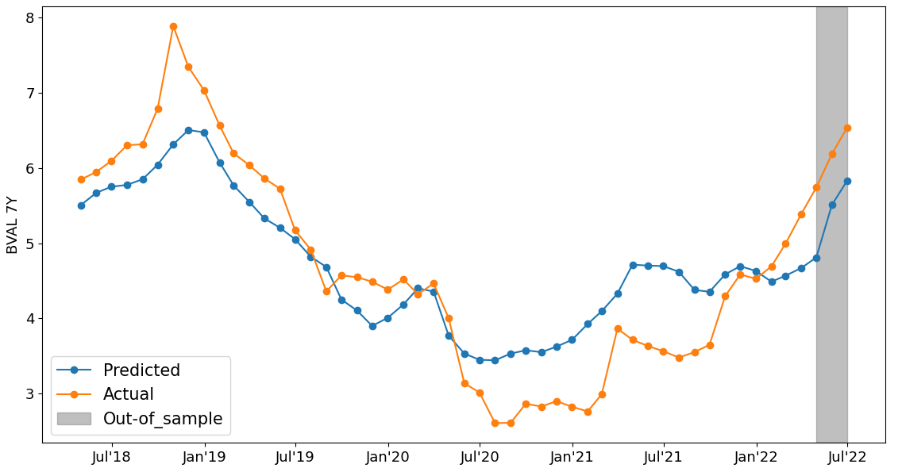
Model (1), Actual vs Predicted
 | MAPE
In-sample | 14.2%
Out-of-sample | 12.6%

Slide 4
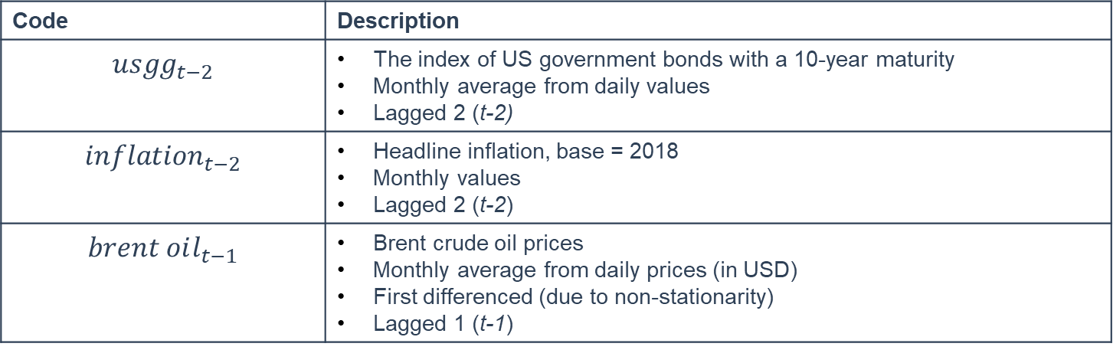
Model (2)
$$BVAL 10Y_{t}=2.33+0.99 usgg_{t−2}+0.21 inflation_{t−2}+0.02 brent oil_{t−1}$$
Code | Description
$$usgg_{t−2}$$ | The index of US government bonds with a 10-year maturity Monthly average from daily values Lagged 2 (t-2)
$$inflation_{t−2}$$ | Headline inflation, base = 2018 Monthly values Lagged 2 (t-2)
$$brent oil_{t−1}$$ | Brent crude oil prices Monthly average from daily prices (in USD) First differenced (due to non-stationarity) Lagged 1 (t-1)
Note: BVAL 10Y, USGG, and inflation are multiplied by 100, e.g., 4% = 4
Model passed linear regression assumptions (see Annex for detailed values)
Cochrane-Orcutt procedure was implemented (see Annex for detailed values)

Slide 5
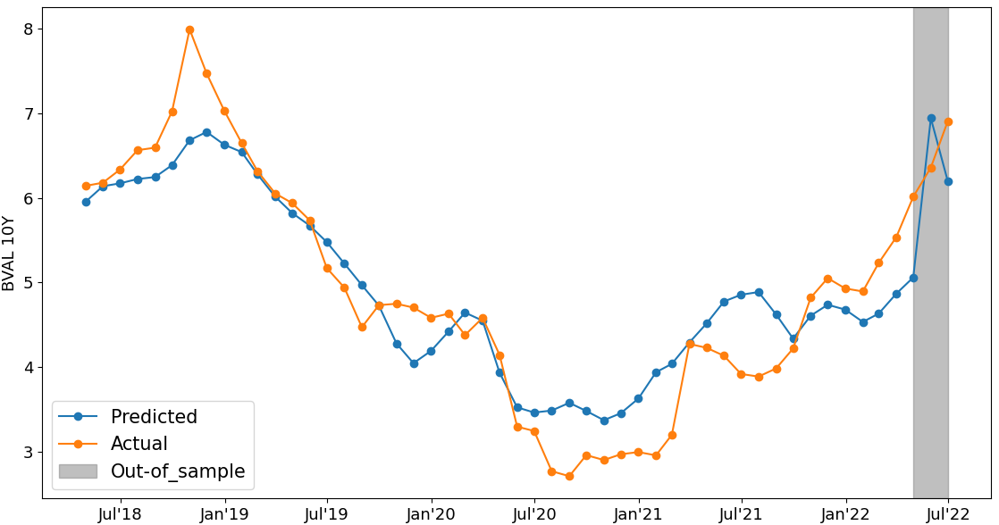
Model (2), Actual vs Predicted
 | MAPE
In-sample | 9.9%
Out-of-sample | 11.8%

Slide 6
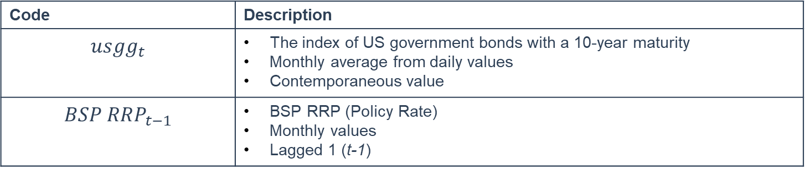
Model (3)
$$BSP RRP_{t}=−1.10+0.91 BSP RRP_{t−1}+0.19 usgg_{t}$$
Code | Description
$$usgg_{t}$$ | The index of US government bonds with a 10-year maturity Monthly average from daily values Contemporaneous value
$$BSP RRP_{t−1}$$ | BSP RRP (Policy Rate) Monthly values Lagged 1 (t-1)
Note: All the variables are multiplied by 100, e.g., 4% = 4
Model passed linear regression assumptions (see Annex for detailed values)
Cochrane-Orcutt procedure was implemented (see Annex for detailed values)

Slide 7
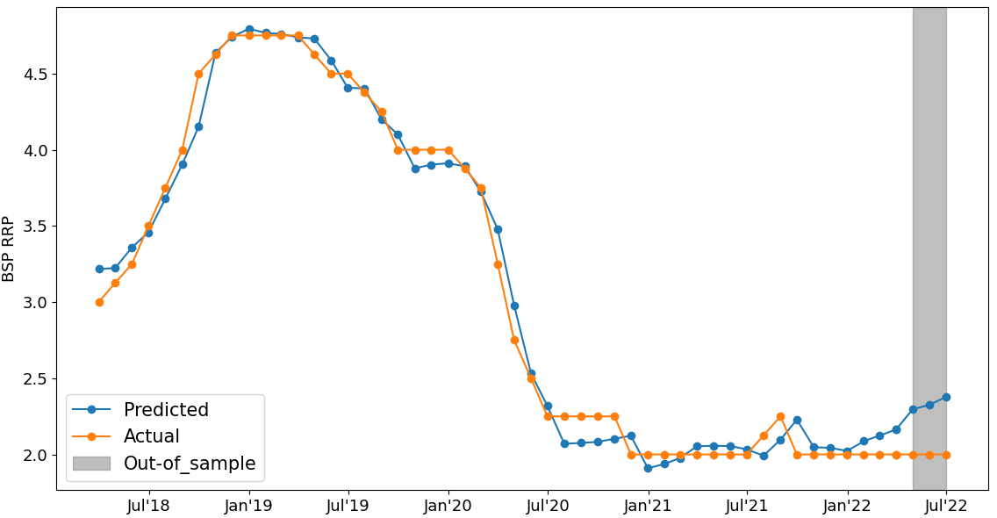
Model (3), Actual vs Predicted
 | MAPE
In-sample | 3.5%
Out-of-sample | 14.5%

Slide 8
Annex

Slide 9
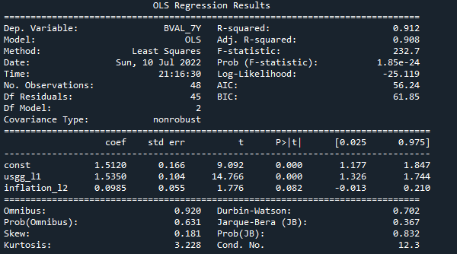
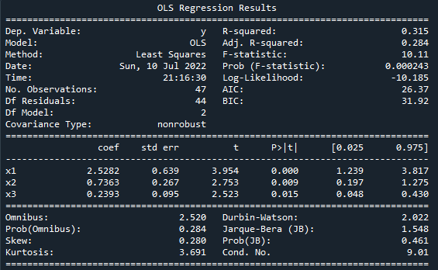
Model (1)
Initial OLS result
OLS result after Cochrane-Orcutt Procedure

Slide 10
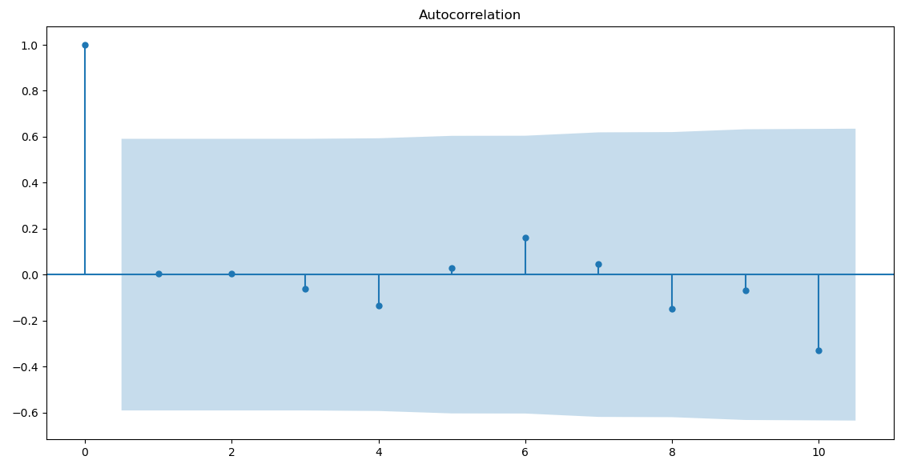
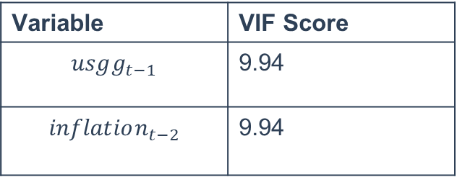
Model (1), Robust check
TEST | Score
Normality – Shapiro-wilk test | P-value = 0.38 (Ho = Normal distribution)
Variance – Breusch-Pagan p-value | P-value = 0.09 (Ho = Constant variance)
Serial correlation – Durbin-Watson | DB stat = 2.02 (1.5-2.5 = No serial correlation)
Variable | VIF Score
$$usgg_{t−1}$$ | 9.94
$$inflation_{t−2}$$ | 9.94
Multicollinearity threshold is based on KPMG’s threshold (VIF < 10)

Slide 11
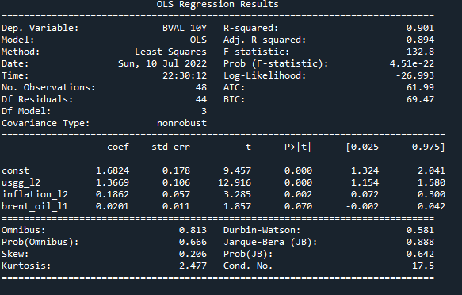
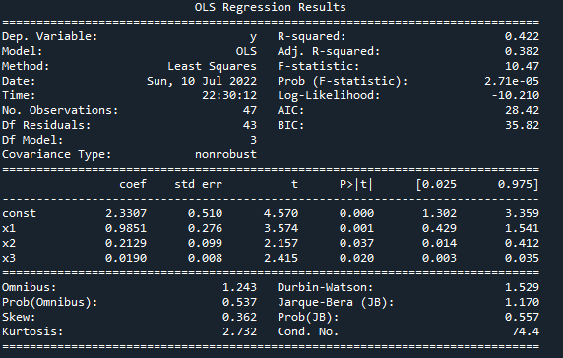
Model (2)
Initial OLS result
OLS result after Cochrane-Orcutt Procedure

Slide 12
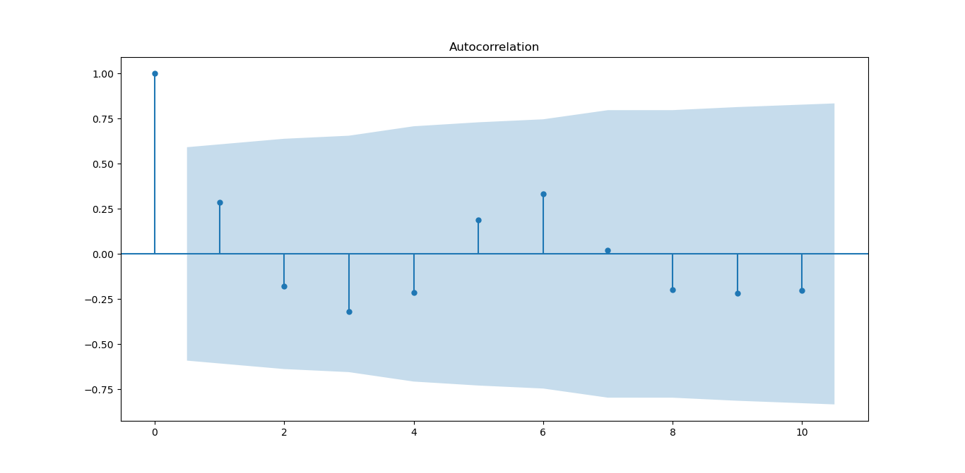
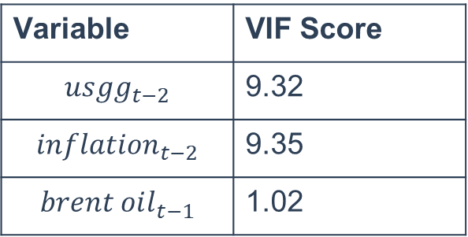
Model (2), Robust check
TEST | Score
Normality – Shapiro-wilk test | P-value = 0.45 (Ho = Normal distribution)
Variance – Breusch-Pagan p-value | P-value = 0.06 (Ho = Constant variance)
Serial correlation – Durbin-Watson | DB stat = 1.53 (1.5-2.5 = No serial correlation)
Variable | VIF Score
$$usgg_{t−2}$$ | 9.32
$$inflation_{t−2}$$ | 9.35
$$brent oil_{t−1}$$ | 1.02
Multicollinearity threshold is based on KPMG’s threshold (VIF < 10)

Slide 13
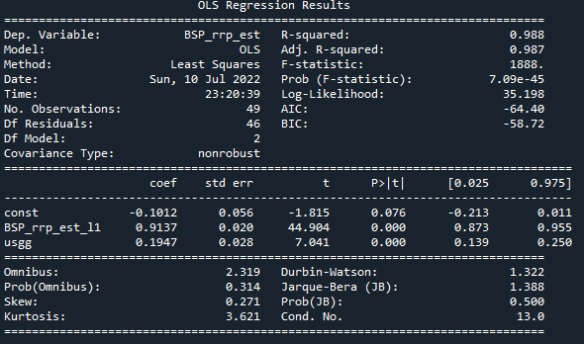
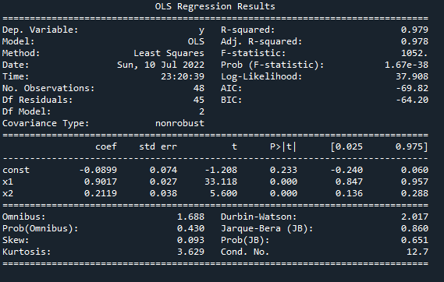
Model (3)
Initial OLS result
OLS result after Cochrane-Orcutt Procedure

Slide 14
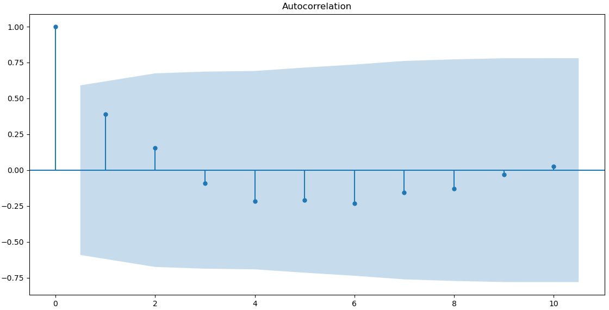
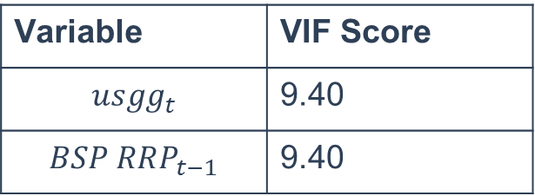
Model (3), Robust check
TEST | Score
Normality – Shapiro-wilk test | P-value = 0.93 (Ho = Normal distribution)
Variance – Breusch-Pagan p-value | P-value = 0.67 (Ho = Constant variance)
Serial correlation – Durbin-Watson | DB stat = 2.02 (1.5-2.5 = No serial correlation)
Variable | VIF Score
$$usgg_{t}$$ | 9.40
$$BSP RRP_{t−1}$$ | 9.40
Multicollinearity threshold is based on KPMG’s threshold (VIF < 10)

